Slide 1
Evolution Exam Review

Slide 2
Review
Somatic cells -
Cells that _______________________, that are _________________(sex/reproductive) cells.
Has a ____________ number of chromosomes
Goes through ___________ and cytokinesis
Germ cells (sex cells)
The _________________________cells; sperm and egg in mammals
Contain __________ the amount of DNA that is in somatic cells (___________)
Go through ________________

Slide 3
Mutations
Mutation is a _________________in the ________________ of a _________
A nucleotide _____________(s) is either deleted, inserted, substituted or switched
Major source of __________________________

Slide 4
Question 1
Say there is a deletion mutation in the somatic cell of an individual that causes this individual to develop a protein deficiency over their lifespan. If this individual decides to reproduce, will his/her offspring inherit this mutation? Why or why not?

Slide 5
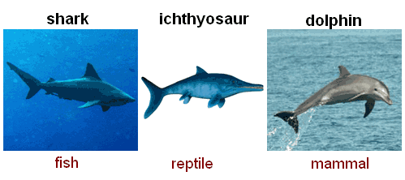
______________evolution – Process in which species that are ________________________to each other ______________ evolve similar kinds of traits. Ex: hawks, bats and butterflies all have wings. But none of these organisms inherited these genes from any of the others. These independently evolved wings are called ______________________________.

Slide 6
___________evolution : can be difficult to distinguish from convergent evolution. Parallel evolution occurs when ________________start with __________ __________, then evolve ____________
_______________. This kind of thing happens because the two different species, though they don't necessarily share a common ancestor, experience _______________
____________________ and survive only by undergoing similar adaptations. A classic example of parallel evolution is found among plants, in which several similar but distinct forms of leaf evolved in parallel and are evident today.

Slide 7
____________evolution : process where ______ _________________________ evolves into _________ ______________over time. A common example of divergent evolution is the __________________ ______. Whale flippers, frog forelimbs, and your own arms most likely evolved from an ancient common ancestor. Because they share a ________ ___________ _________, these are examples of ______________structures.

Slide 8
______________: when closely interacting species exert selective pressures on each other, so that they ______________________. Examples of coevolution are common among predator-prey and host-parasite pairs. A better example: hummingbirds and the flowers from which they seek nectar and unwittingly pollinate

Slide 9
______________________– In biological terms, a trait that has _________________from an ___________ state. The five digits of the human hand and foot are primitive traits inherited from earlier vertebrate ancestors.
_____________ traits –
A trait that has ____________from an __________ state. The large human brain is a derived trait relative to the common ancestor of humans and apes.

Slide 10
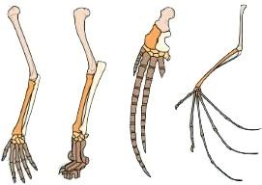
1. The image illustrates what evolutionary concept? A)embryological similarities B)variation among species C)vestigial structures D)homologous structures

Slide 11
Natural Selection
___________ proposed the theory of natural selection as the mechanism ____________________________.
___________________– used to describe natural selection
___________ – is a measure of an individual’s __________________to the ____________________________.
Adaptations – are _____________________________ and populations tend to be well adapted to survive in their environments

Slide 12
The dog breeds we have today were developed through: A) natural selection B)artificial selection (selective breeding) C)sexual selection D)acquired selection

Slide 13
Something to think About
The dog breeds we have today were developed through artificial selection, what could be some major implications of this?

Slide 14
Parts of Natural Selection
__________________– A species has more offspring that will survive until ____________ (offspring need food, are vulnerable to ____________and diseases)
________________– The individuals of a population may ________________such as size, color, strength, speed, ability to find food, or resistance to certain ___________.

Slide 15
Parts of Natural Selection
Struggle to survive – Individuals must compete with each other for limited resources. Some will be harmed by predation, diseases, or unfavorable conditions.
Differential reproduction – Individuals that have certain traits are more likely to survive and reproduce than are individuals that lack those traits. Over time the favorable traits become more frequent in the population.

Slide 16
True or false?
Adaptation is the physiological change that occurs in an organism’s lifetime.
____________, an adaptation is a __________ that makes an individual ___________________________

Slide 17
Evidence for Evolution
Fossil/Fossil Record –evidence of organisms that lived on Earth in the past. Fossils show ____________________diversity over geologic __________.
Comparative anatomy - the __________study of the ___________________of different species of animals in order to understand the ______________________they have undergone in the course of evolution from common ancestors.
Homologous structures, analogous structures
_____________ structures - structures that have lost their function but are still present. Ex) legs of skinks, ___________ in humans

Slide 18
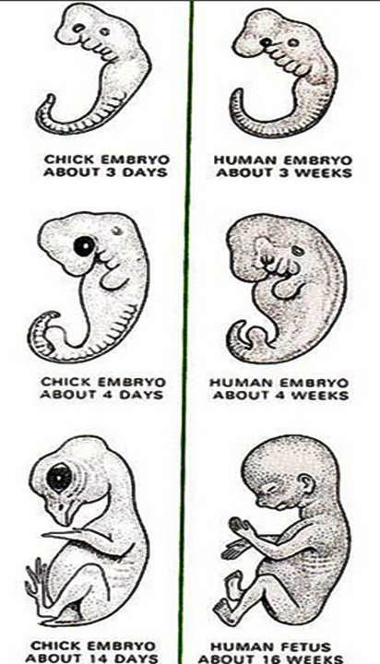
Evidence for Evolution
Comparative embryology –
comparing ______________ of
various species : point toward a
______________________.
Biogeography - Biogeography is the study of the __________________________________________________________. (Why does the Arctic have polar bears and Antarctica penguins?)

Slide 19
Evidence for Evolution
_____________________–scientists look at the _____________and other ______________ that ____________________. While these molecules can evolve just as an entire organism can, some important molecules are __________________among species. The slight _______________ that occur over time in these conserved molecules, which are often called ______________, can help shed light on past evolutionary events.
__________________________ change – Changes in evolution we have directly observed.
http://www.youtube.com/watch?v=9x8lFXgXmZI

