Slide 1
Evolution Exam Review

Slide 2
Review
Somatic cells -
Cells that make up an organism, that are NOT germ (sex/reproductive) cells.
Has a diploid number of chromosomes
Go through mitosis and cytokinesis
Germ cells (sex cells)
The sexually reproductive cells; sperm and egg in mammals
Contain HALF the amount of DNA that is in somatic cells (Haploid)
Go through meiosis

Slide 3
Mutations
Mutation is a permanent change in the DNA sequence of a gene
A nucleotide base pair(s) is either deleted, inserted, substituted or switched
Major source of genetic variation

Slide 4
Question 1
Say there is a deletion mutation in the somatic cell of an individual that causes this individual to develop a protein deficiency over their lifespan. If this individual decides to reproduce, will his/her offspring inherit this mutation? Why or why not?

Slide 5
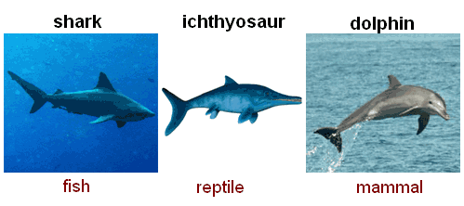
Convergent evolution – Process in which species that are NOT closely related to each other independently evolve similar kinds of traits. Ex: hawks, bats and butterflies all have wings. But none of these organisms inherited these genes from any of the others. These independently evolved wings are called analogous structures.

Slide 6
Parallel evolution : can be difficult to distinguish from convergent evolution. Parallel evolution occurs when different species start with similar ancestral origins, then evolve similar traits over time. This kind of thing happens because the two different species, though they don't necessarily share a common ancestor, experience similar kinds of environmental pressures and survive only by undergoing similar adaptations. A classic example of parallel evolution is found among plants, in which several similar but distinct forms of leaf evolved in parallel and are evident today.

Slide 7
Divergent evolution : process where trait in common ancestor evolves into different variations over time. A common example of divergent evolution is the vertebrate limb. Whale flippers, frog forelimbs, and your own arms most likely evolved from an ancient common ancestor. Because they share a common evolutionary origin, these are examples of homologous structures.

Slide 8
Coevolution: when closely interacting species exert selective pressures on each other, so that they evolve together. Examples of coevolution are common among predator-prey and host-parasite pairs. A better example: hummingbirds and the flowers from which they seek nectar and unwittingly pollinate

Slide 9
Primitive traits – In biological terms, a trait that has not changed from an ancestral state. The five digits of the human hand and foot are primitive traits inherited from earlier vertebrate ancestors.
Derived traits –
A trait that has changed from an ancestral state. The large human brain is a derived trait relative to the common ancestor of humans and apes.

Slide 10
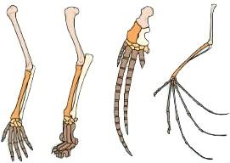
1. The image illustrates what evolutionary concept? A)embryological similarities B)variation among species C)vestigial structures D)homologous structures

Slide 11
Natural Selection
Darwin proposed the theory of natural selection as the mechanism for descent with modification.
Survival of the fittest – used to describe natural selection
Fitness – is a measure of an individual’s hereditary contribution to the next generation.
Adaptations – are traits that increase the fitness of individuals and populations tend to be well adapted to survive in their environments

Slide 12
The dog breeds we have today were developed through: A) natural selection B)artificial selection (selective breeding) C)sexual selection D)acquired selection

Slide 13
Something to think About
The dog breeds we have today were developed through artificial selection, what could be some major implications of this?

Slide 14
Parts of Natural Selection
Overproduction – A species has more offspring that will survive until maturity (offspring need food, are vulnerable to predators and diseases)
Genetic variation – The individuals of a population may differ in traits such as size, color, strength, speed, ability to find food, or resistance to certain diseases.

Slide 15
Parts of Natural Selection
Struggle to survive – Individuals must compete with each other for limited resources. Some will be harmed by predation, diseases, or unfavorable conditions.
Differential reproduction – Individuals that have certain traits are more likely to survive and reproduce than are individuals that lack those traits. Over time the favorable traits become more frequent in the population.

Slide 16
True or false?
Adaptation is the physiological change that occurs in an organism’s lifetime.
False, an adaptation is a trait that makes an individual successful in its environment

Slide 17
Evidence for Evolution
Fossil/Fossil Record –evidence of organisms that lived on Earth in the past. Fossils show change in species diversity over geologic time
Comparative anatomy - the comparative study of the body structures of different species of animals in order to understand the adaptive changes they have undergone in the course of evolution from common ancestors.
Homologous structures, analogous structures
Vestigial structures - structures that have lost their function but are still present. Ex) legs of skinks, appendix in humans

Slide 18
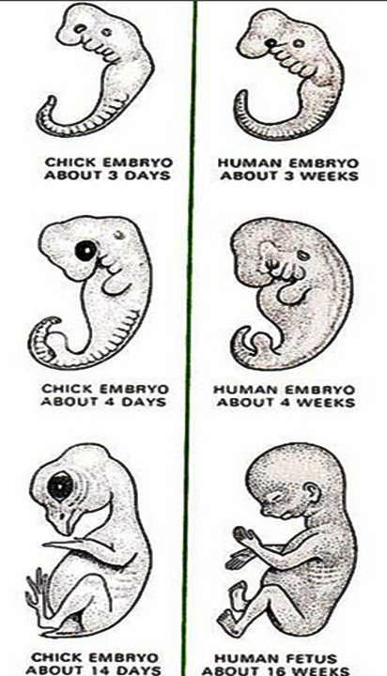
Evidence for Evolution
Comparative embryology –
comparing embryos of
various species : point toward a
common ancestor.
Biogeography - Biogeography is the study of the distribution of life forms over geographical areas. (Why does the Arctic have polar bears and Antarctica penguins?)

Slide 19
Evidence for Evolution
Molecular biology –scientists look at the proteins and other molecules that control life processes. While these molecules can evolve just as an entire organism can, some important molecules are highly conserved among species. The slight changes that occur over time in these conserved molecules, which are often called molecular clocks, can help shed light on past evolutionary events.
Observed evolutionary change – Changes in evolution we have directly observed.
http://www.youtube.com/watch?v=9x8lFXgXmZI

